Slide 1
Cornerstone City Church Peninsula Plus Community Hoo Are Ya
10-09-2023

Slide 2
We Want To See Jesus Lifted High
CCLI Song # 1033408
© 1993 Thankyou Music
For use solely with the SongSelect® Terms of Use. All rights reserved. www.ccli.com
Note: Reproduction of this sheet music requires a CCLI Music Reproduction Licence. Please report all copies.
CCLI Licence No. 33265

Slide 3
1/4
We want to see Jesus lifted high
A banner that flies across this land
That all men might see the truth and know
He is the way to heaven

Slide 4
2/4
We want to see we want to see
We want to see Jesus lifted high
We want to see we want to see
We want to see Jesus lifted high

Slide 5
3/4
Step by step we're moving forward
Little by little taking ground
Ev’ry prayer a powerful weapon
Strongholds come tumbling down
And down and down and down

Slide 6
4/4
We're gonna see we're gonna see
We're gonna see Jesus lifted high
We're gonna see we're gonna see
We're gonna see Jesus lifted high

Slide 7
Open The Eyes of My Heart
CCLI Song # 2298355
Paul Baloche
© 1997 Integrity's Hosanna! Music (Admin. by Integrity Music Ltd)
For use solely with the SongSelect® Terms of Use. All rights reserved. www.ccli.com
CCLI Licence No. 33265

Slide 8
1/3
Open the eyes of my heart Lord
Open the eyes of my heart
I want to see You
I want to see You

Slide 9
2/3
To see You high and lifted up
Shining in the light of Your glory
Pour out Your power and love
As we sing holy holy holy

Slide 10
3/3
Holy holy holy
Holy holy holy
Holy holy holy
I want to see You

Slide 11


Slide 12
I Give You My Heart
CCLI Song # 1866132
Reuben Morgan
© 1995 Hillsong Music Publishing Australia (Admin. by Hillsong Music Publishing UK)
For use solely with the SongSelect® Terms of Use. All rights reserved. www.ccli.com
CCLI Licence No. 33265

Slide 13
1/2
This is my desire
To honour You
Lord with all my heart
I worship You
All I have within me
I give You praise
All that I adore is in You

Slide 14
2/2
Lord I give You my heart
I give You my soul
I live for You alone
Ev'ry breath that I take
Ev'ry moment I'm awake
Lord have Your way in me

Slide 15
Shout To The Lord
CCLI Song # 1406918
Darlene Zschech
© 1993 Wondrous Worship (Admin. by Song Solutions www.songsolutions.org)
For use solely with the SongSelect® Terms of Use. All rights reserved. www.ccli.com
CCLI Licence No. 33265

Slide 16
1/3
My Jesus my Saviour
Lord there is none like You
All of my days I want to praise
The wonders of Your mighty love
My comfort my shelter
Tower of refuge and strength
Let every breath all that I am
Never cease to worship You

Slide 17
2/3
Shout to the Lord
All the earth let us sing
Power and majesty
Praise to the King
Mountains bow down
And the seas will roar
At the sound of Your name

Slide 18
3/3
I sing for joy
At the work of Your hands
Forever I'll love You
Forever I'll stand
Nothing compares to the promise
I have in You

Slide 19
What A Beautiful Name
CCLI Song # 7068424
Ben Fielding | Brooke Ligertwood
© 2016 Hillsong Music Publishing Australia (Admin. by Hillsong Music Publishing UK)
For use solely with the SongSelect® Terms of Use. All rights reserved. www.ccli.com
CCLI Licence No. 33265

Slide 20
1/7
You were the Word at the beginning One with God the Lord Most High Your hidden glory in creation Now revealed in You our Christ

Slide 21
2/7
What a beautiful Name it is What a beautiful Name it is The Name of Jesus Christ my King What a beautiful Name it is Nothing compares to this What a beautiful Name it is The Name of Jesus

Slide 22
3/7
You didn't want heaven without us So Jesus You brought heaven down My sin was great Your love was greater What could separate us now

Slide 23
4/7
What a wonderful Name it is What a wonderful Name it is The Name of Jesus Christ my King What a wonderful Name it is Nothing compares to this What a wonderful Name it is The Name of Jesus What a wonderful Name it is The Name of Jesus

Slide 24
5/7
Death could not hold You The veil tore before You You silence the boast of sin and grave The heavens are roaring The praise of Your glory For You are raised to life again

Slide 25
6/7
You have no rival You have no equal Now and forever God You reign Yours is the kingdom Yours is the glory Yours is the Name above all names

Slide 26
7/7
What a powerful Name it is What a powerful Name it is The Name of Jesus Christ my King What a powerful Name it is Nothing can stand against What a powerful Name it is The Name of Jesus

Slide 28
Holy Forever
CCLI Song # 7201044
Brian Johnson | Chris Tomlin | Jason Ingram | Jenn Johnson | Phil Wickham
© Phil Wickham Music (Admin. by / Small Stone Media BV, Holland (Admin. in the UK/Eire by Song Solutions www.songsolutions.org))
Simply Global Songs (Admin. by / Small Stone Media BV, Holland (Admin. in the UK/Eire by Song Solutions www.songsolutions.org))
Capitol CMG Paragon (Admin. by Capitol CMG Publishing)
S. D. G. Publishing (Admin. by Capitol CMG Publishing)
Be Essential Songs (Admin. by Essential Music Publishing LLC)
My Magnolia Music (Admin. by Essential Music Publishing LLC)
Bethel Music Publishing (Admin. by Song Solutions)
Brian and Jenn Publishing (Admin. by Song Solutions)
For use solely with the SongSelect® Terms of Use. All rights reserved. www.ccli.com
CCLI Licence No. 33265

Slide 29
1/10
A thousand generations falling down in worship
To sing the song of ages to the Lamb
And all who've gone before us
And all who will believe
Will sing the song of ages to the Lamb

Slide 30
2/10
(Jesus) Your name is the highest
Your name is the greatest
Your name stands above them all
All thrones and dominions
All powers and positions
Your name stands above them all

Slide 31
3/10
And the angels cry Holy
All creation cries Holy
You are lifted high Holy
Holy forever

Slide 32
4/10
If you've been forgiven and if you've been redeemed
Sing the song forever to the Lamb
If you walk in freedom and if you bear His name
Sing the song forever to the Lamb
We'll sing the song forever and amen

Slide 33
5/10
And the angels cry Holy
All creation cries Holy
You are lifted high Holy
Holy forever

Slide 34
6/10
Hear Your people sing Holy
To the King of Kings Holy
You will always be Holy
Holy forever

Slide 35
7/10
(Jesus) Your name is the highest
Your name is the greatest
Your name stands above them all
All thrones and dominions
All powers and positions
Your name stands above them all

Slide 36
8/10
And the angels cry Holy
All creation cries Holy
You are lifted high Holy
Holy forever

Slide 37
9/10
Hear Your people sing Holy
To the King of Kings Holy
You will always be Holy
Holy forever

Slide 38
10/10
You will always be Holy
Holy forever

Slide 39


Slide 40
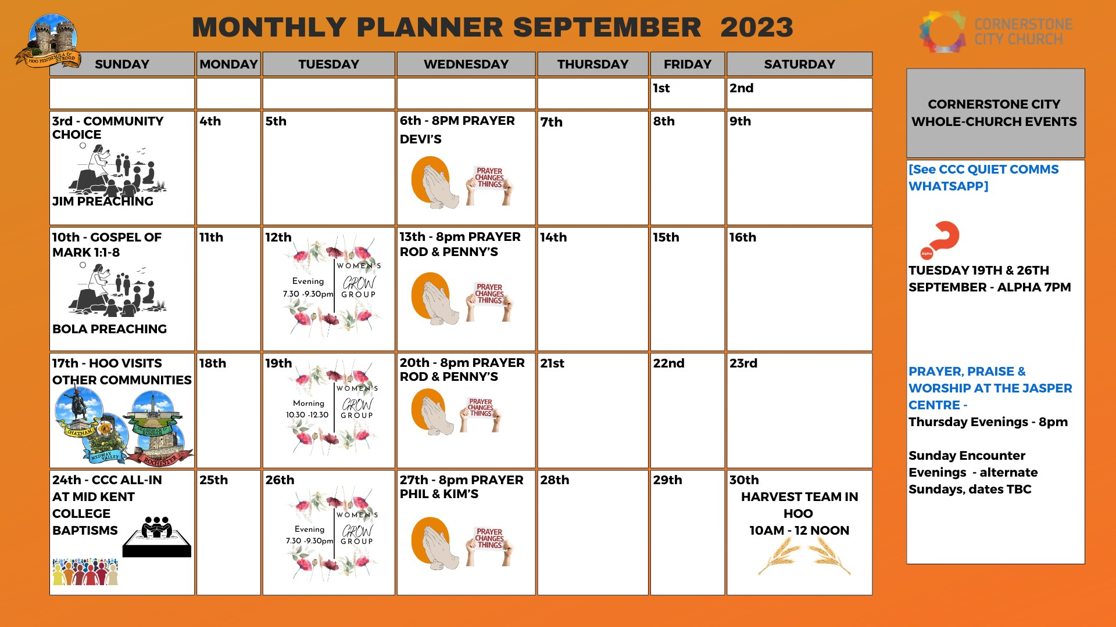

Slide 41
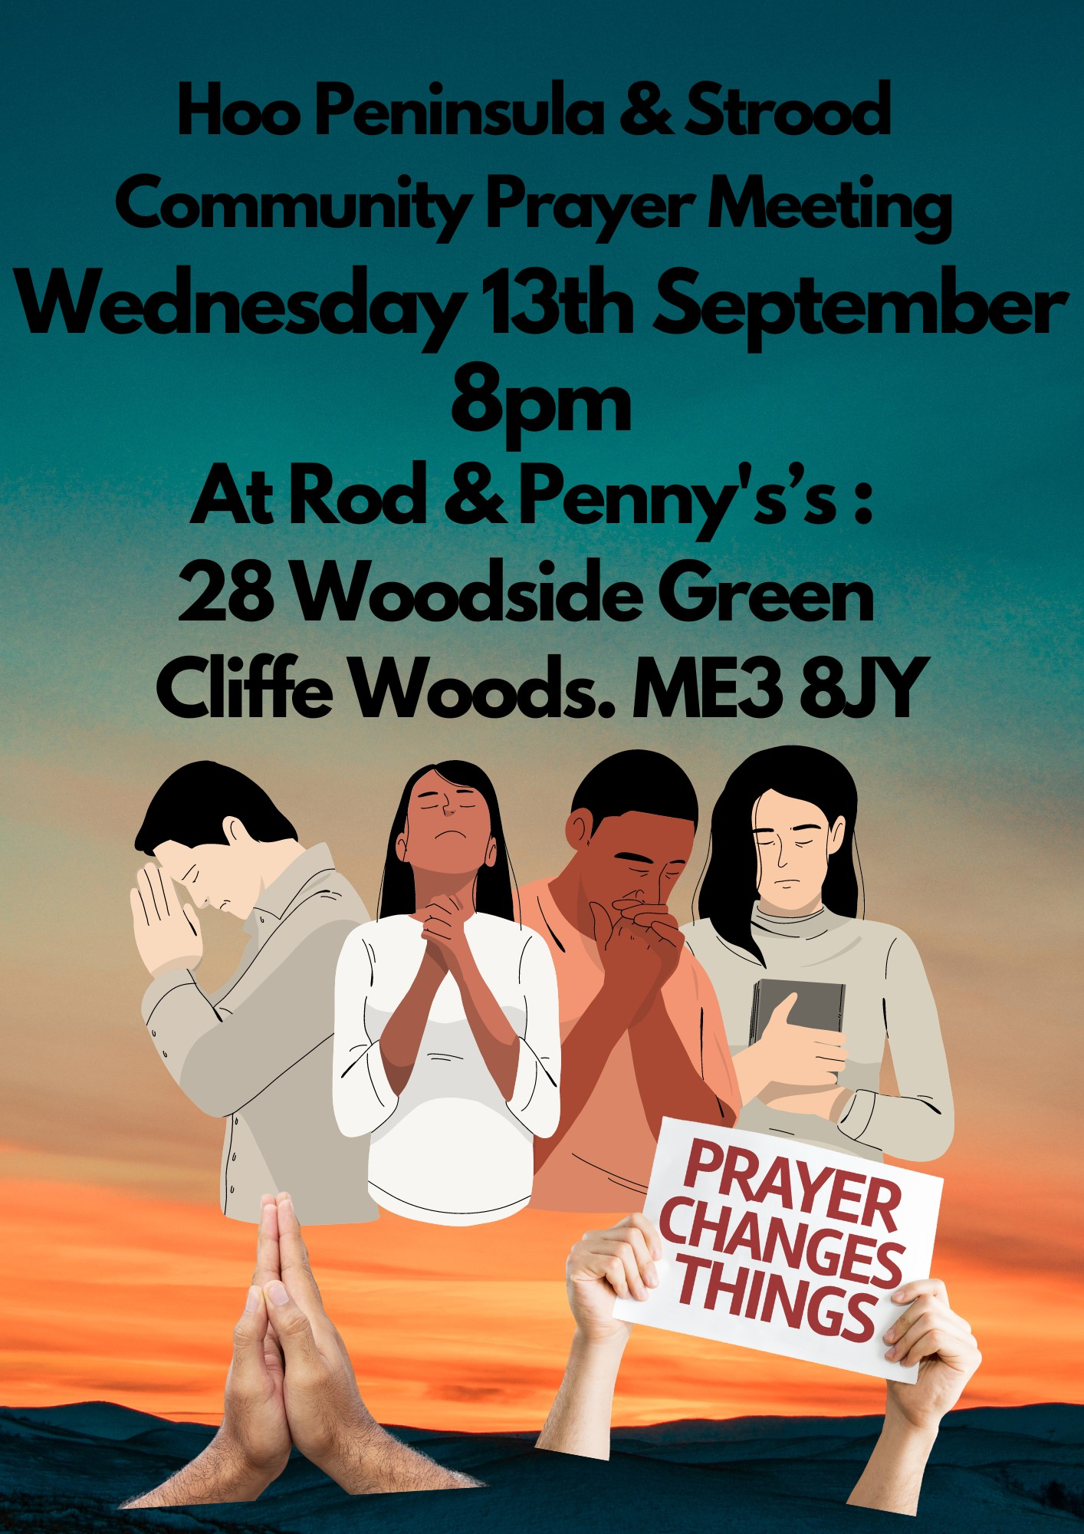

Slide 42


Slide 43


Slide 44


Slide 45
Worthy Of it All
CCLI Song # 6280644
David Brymer | Ryan Hall
© 2012 Common Hymnal Publishing (Admin. by Integrity Music Ltd)
Innerland (Admin. by Integrity Music Ltd)
Underground Treasure (Admin. by Integrity Music Ltd)
Wayfinder Music (Admin. by Integrity Music Ltd)
For use solely with the SongSelect® Terms of Use. All rights reserved. www.ccli.com
CCLI Licence No. 33265

Slide 46
1/3
All the saints and angels
Bow before Your throne
All the elders cast their crowns
Before the Lamb of God and sing

Slide 47
2/3
You are worthy of it all
You are worthy of it all
For from You are all things
And to You are all things
You deserve the glory

Slide 48
3/3
Day and night,
Night and day,
Let incense arise
(X4)
Day and night
Night and day

Slide 49
2 Corinthians 14 May the grace of the Lord Jesus Christ, and the love of God, and the fellowship of the Holy Spirit be with you all

